Slide 1
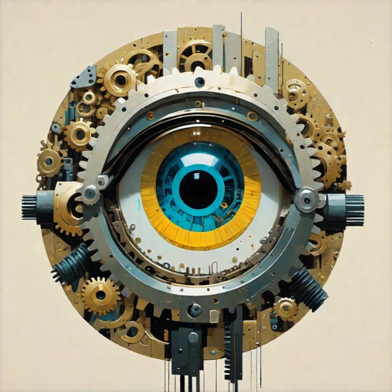
Your
Logo
Results
Notes:
What is it that we are doing?

Slide 2
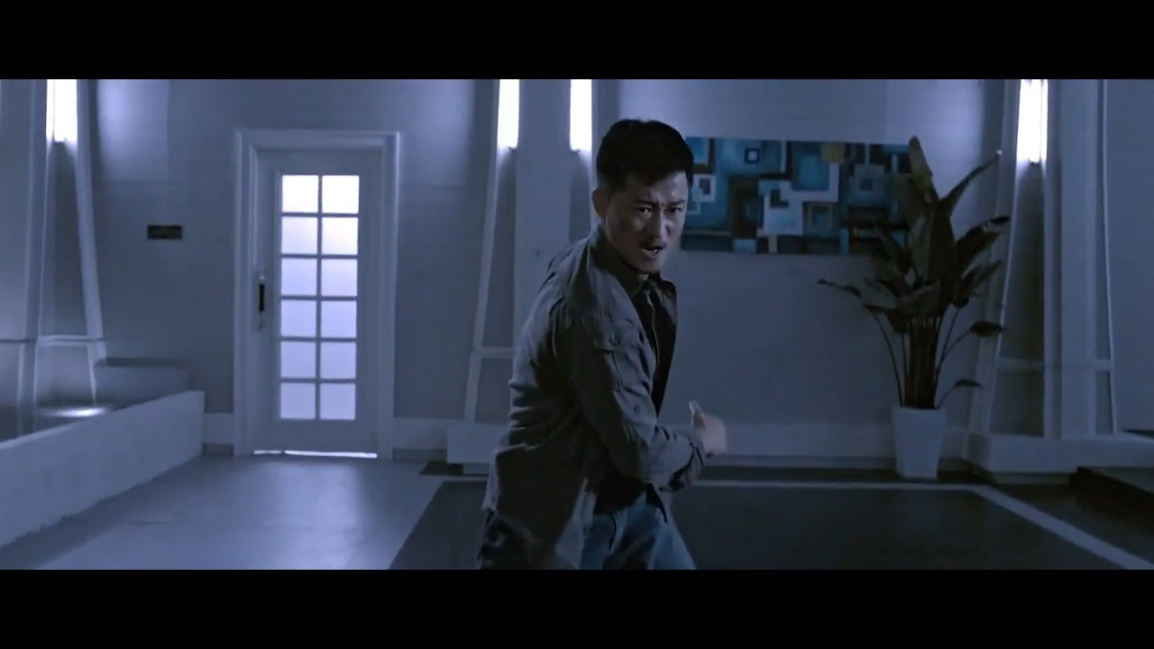
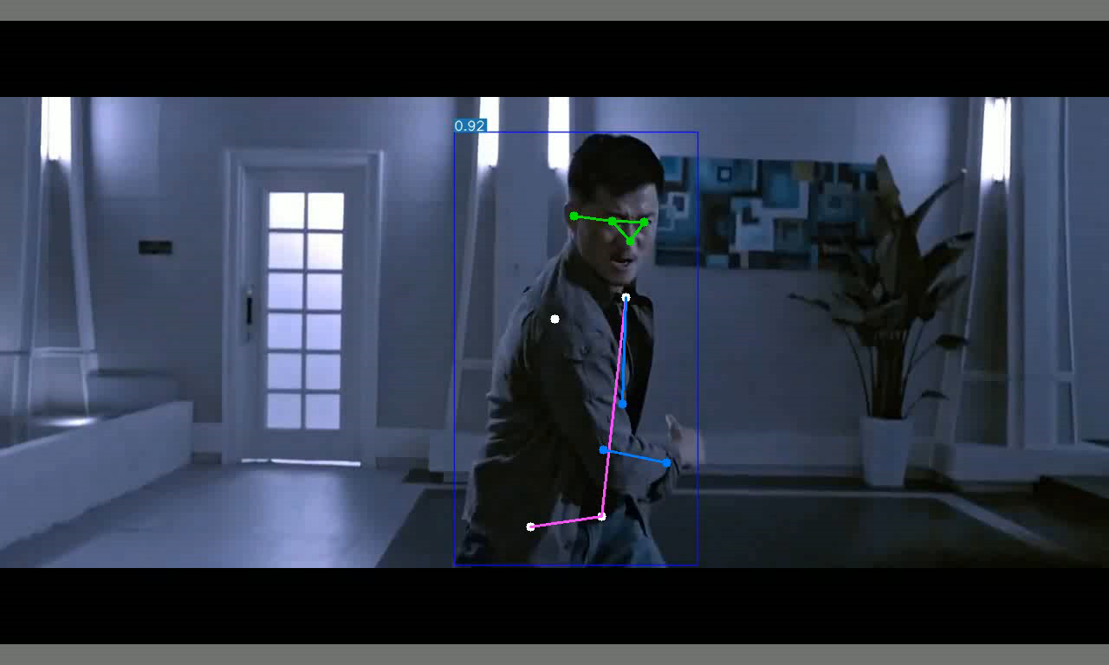
Output of Our Models
Pose Estimation and Person Fell Down Model
Input
Output

Slide 3
References
Fig1:https://projectsafetyjournal.com/construction-deaths-drop-25
Fig2:Numan Khan, Syed Farhan Alam Zaidi, Jaehun Yang, Construction Work-Stage-Based Rule Compliance Monitoring Framework Using Computer Vision (CV) Technology
Fig3: Numan Khan, Syed Farhan Alam Zaidi, Jaehun Yang, Construction Work-Stage-Based Rule Compliance Monitoring Framework Using Computer Vision (CV) Technology
Fig4: Person detection by CV and Drones: https://viso.ai/applications/computer-vision-in-construction/
PPE-Video: https://www.computervision.zone/topic/demo-videos/
Pos-detect-video: Film name : ‘‘A Time for Consequences’’

